Slide 1
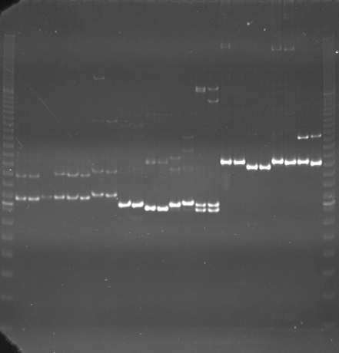
VES0049
VES0050
VES0051
m
Ac
Aw
Bc
Bw
Rc
Rw
Mc
Mw
Ac
Aw
Bc
Bw
Rc
Rw
Mc
Mw
Ac
Aw
Bc
Bw
Rc
Rw
Mc
Mw
m

Slide 2
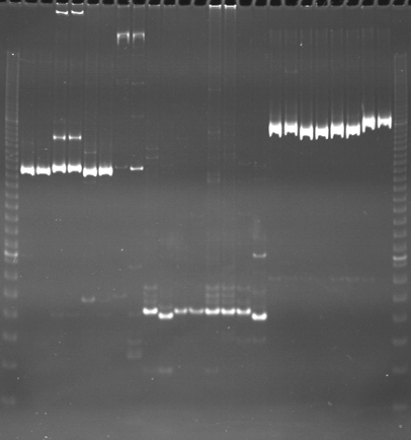
VES0052
VES0053
VES0054
m
Ac
Aw
Bc
Bw
Rc
Rw
Mc
Mw
Ac
Aw
Bc
Bw
Rc
Rw
Mc
Mw
Ac
Aw
Bc
Bw
Rc
Rw
Mc
Mw
m

Slide 3
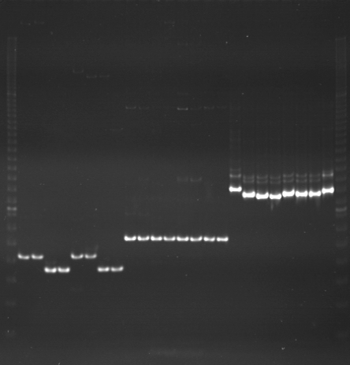
VES0055
VES0056
VES0057
m
Ac
Aw
Bc
Bw
Rc
Rw
Mc
Mw
Ac
Aw
Bc
Bw
Rc
Rw
Mc
Mw
Ac
Aw
Bc
Bw
Rc
Rw
Mc
Mw
m

Slide 4
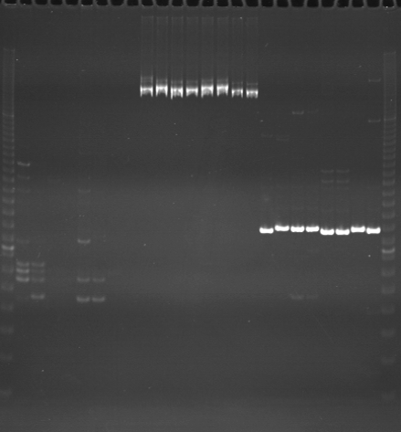
VES0058
VES0059
VES0060
m
Ac
Aw
Bc
Bw
Rc
Rw
Mc
Mw
Ac
Aw
Bc
Bw
Rc
Rw
Mc
Mw
Ac
Aw
Bc
Bw
Rc
Rw
Mc
Mw
m

Slide 5
VES0061
VES0062
VES0063
m
Ac
Aw
Bc
Bw
Rc
Rw
Mc
Mw
Ac
Aw
Bc
Bw
Rc
Rw
Mc
Mw
Ac
Aw
Bc
Bw
Rc
Rw
Mc
Mw
m

Slide 6
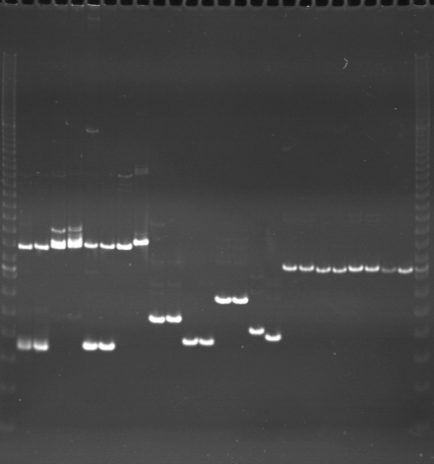
VES0064
VES0065
VES0066
m
Ac
Aw
Bc
Bw
Rc
Rw
Mc
Mw
Ac
Aw
Bc
Bw
Rc
Rw
Mc
Mw
Ac
Aw
Bc
Bw
Rc
Rw
Mc
Mw
m

Slide 7
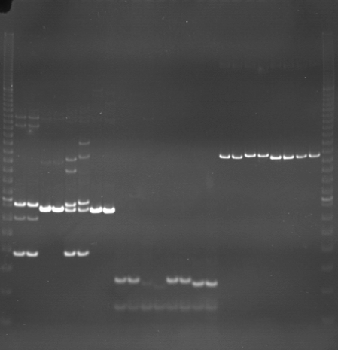
VES0067
VES0068
VES0069
m
Ac
Aw
Bc
Bw
Rc
Rw
Mc
Mw
Ac
Aw
Bc
Bw
Rc
Rw
Mc
Mw
Ac
Aw
Bc
Bw
Rc
Rw
Mc
Mw
m

Slide 8
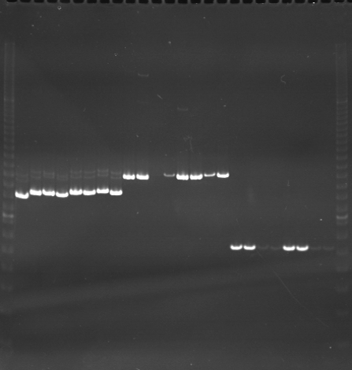
VES0070
VES0071
VES0072
m
Ac
Aw
Bc
Bw
Rc
Rw
Mc
Mw
Ac
Aw
Bc
Bw
Rc
Rw
Mc
Mw
Ac
Aw
Bc
Bw
Rc
Rw
Mc
Mw
m

Slide 9
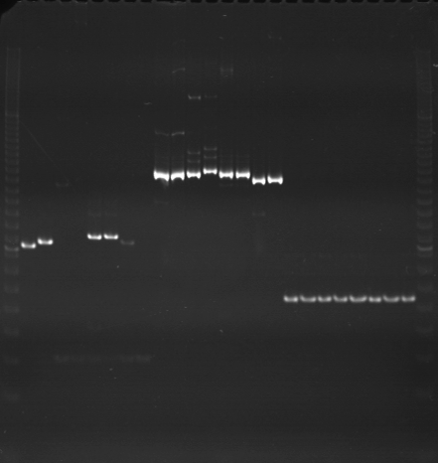
VES0073
VES0074
VES0075
m
Ac
Aw
Bc
Bw
Rc
Rw
Mc
Mw
Ac
Aw
Bc
Bw
Rc
Rw
Mc
Mw
Ac
Aw
Bc
Bw
Rc
Rw
Mc
Mw
m

Slide 10
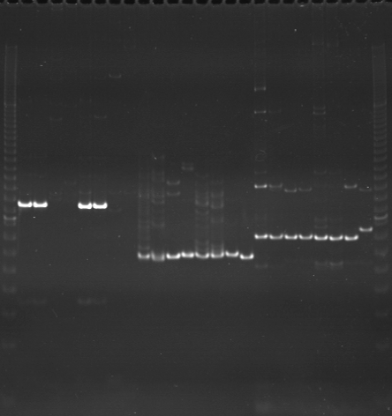
VES0076
VES0077
VES0078
m
Ac
Aw
Bc
Bw
Rc
Rw
Mc
Mw
Ac
Aw
Bc
Bw
Rc
Rw
Mc
Mw
Ac
Aw
Bc
Bw
Rc
Rw
Mc
Mw
m

Slide 11
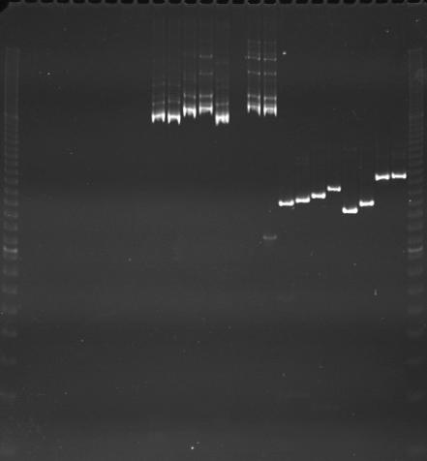
VES0079
VES0080
VES0081
m
Ac
Aw
Bc
Bw
Rc
Rw
Mc
Mw
Ac
Aw
Bc
Bw
Rc
Rw
Mc
Mw
Ac
Aw
Bc
Bw
Rc
Rw
Mc
Mw
m

Slide 12
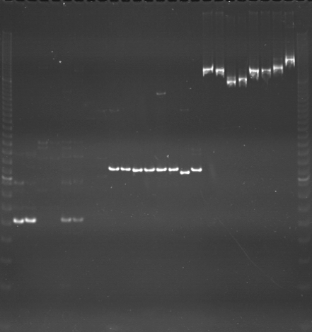
VES0082
VES0083
VES0084
m
Ac
Aw
Bc
Bw
Rc
Rw
Mc
Mw
Ac
Aw
Bc
Bw
Rc
Rw
Mc
Mw
Ac
Aw
Bc
Bw
Rc
Rw
Mc
Mw
m

Slide 13
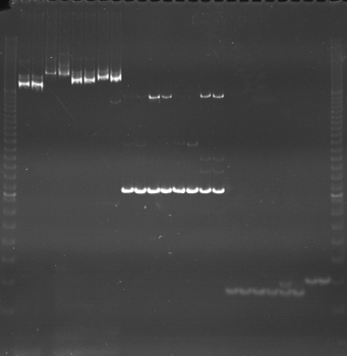
VES0085
VES0086
VES0087
m
Ac
Aw
Bc
Bw
Rc
Rw
Mc
Mw
Ac
Aw
Bc
Bw
Rc
Rw
Mc
Mw
Ac
Aw
Bc
Bw
Rc
Rw
Mc
Mw
m

Slide 14
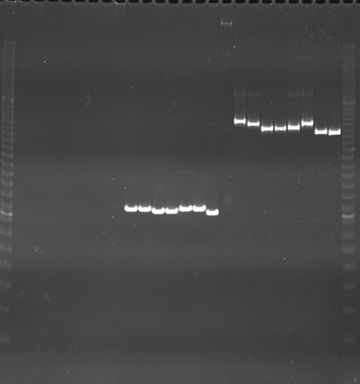
VES0088
VES0089
VES0090
m
Ac
Aw
Bc
Bw
Rc
Rw
Mc
Mw
Ac
Aw
Bc
Bw
Rc
Rw
Mc
Mw
Ac
Aw
Bc
Bw
Rc
Rw
Mc
Mw
m

Slide 15
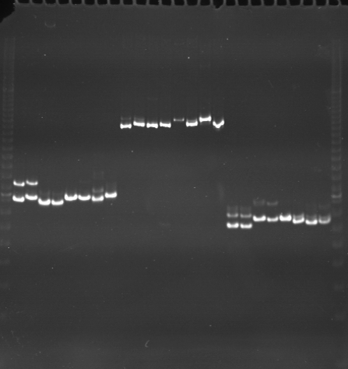
VES0091
VES0092
VES0093
m
Ac
Aw
Bc
Bw
Rc
Rw
Mc
Mw
Ac
Aw
Bc
Bw
Rc
Rw
Mc
Mw
Ac
Aw
Bc
Bw
Rc
Rw
Mc
Mw
m

Slide 16
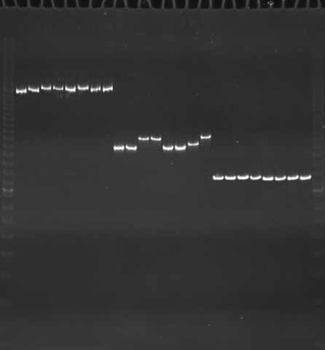
VES0094
VES0095
VES0096
m
Ac
Aw
Bc
Bw
Rc
Rw
Mc
Mw
Ac
Aw
Bc
Bw
Rc
Rw
Mc
Mw
Ac
Aw
Bc
Bw
Rc
Rw
Mc
Mw
m

